Slide 1

B. Tech(IT) Final Presentation- Major Project
Development of an Android-based Pneumonia detection system using deep learning
Presented by:
UDDHAV GUPTA (20BTechIT01)
AMISHA SHARMA (20BTechIT22)
SIDDHANT DAS (20BTechIT45)
MANAB KUMAR DAS (20BTechIT37)
Under the supervision of:
PROF. MD. I. HUSSAIN
Department of Information Technology
North-Eastern Hill University

Slide 2
OUTLINE
INTRODUCTION
PROBLEM STATEMENT
OBJECTIVE
LITERATURE REVIEW
DATASET
X-RAY IMAGE CLASSIFICATION
RESULT AND ANALYSIS
DEPLOYMENT: ANDROID APP
CONCLUSION
REFERENCES

Slide 3
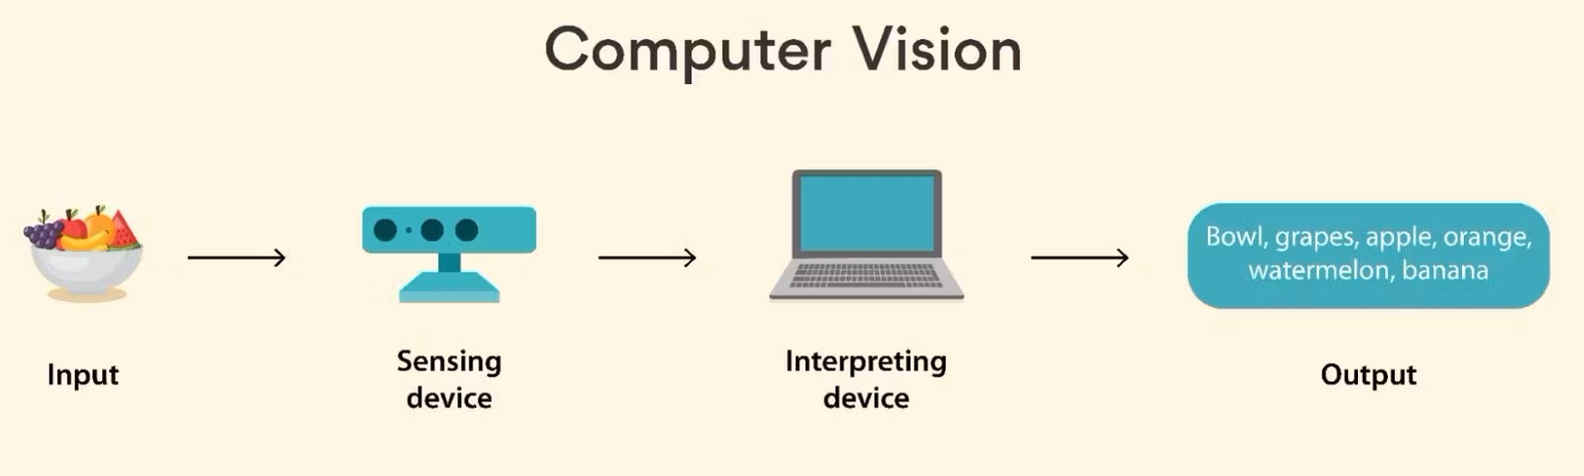
INTRODUCTION
Computer Vision is a field of AI that deals with computational methods to help computers understand and interpret the content of digital images.
Img:1
Computer Vision Generally works in 4 steps:
1: Acquiring the image/video from a camera.
2: Processing the image.
3: Understanding the image using a computer vision technique.
4: Predict the features of the input.

Slide 4
PROBLEM STATEMENT
"Develop and Deploy a deep learning based X-Ray image classification (pneumonia) system on Android Application.”

Slide 5
OBJECTIVE
Developing a Deep Learning based X-Ray image analysis system classifying the X-Ray images in real time.
Integrating the system on an android application for Pneumonia X-Ray Image Classification.

Slide 6
LITERATURE REVIEW
Author | Title | Dataset | Techniques/Methods | Accuracy
Hicham Moujahid, et. al. (2020) [1] | Convolutional Neural Network Based Classification of Patients with Pneumonia using X-ray Lung Images | Labeled Optical Coherence Tomography (OCT) and Chest X-Ray images for Classification | VGG16 ,VGG19, NasNetMobile, ResNet50v2, InceptionResNetV2 | The proposed model achieved following accuracy: VGG16: 96.81% VGG19: 96.58% NasNetMobile: 83.37% ResNet152V2: 96.35% InceptionResNetV2: 94.87%
Dimpy Varshni, et al. (2019)[2] | Pneumonia Detection Using CNN-based Feature Extraction | Chest X-Ray Images (covid-19) | DenseNet-169 CNN model | Model achieved AUC of 0.8002
Md. Iftekhar Hussain et al. (2020)[3] | Automatic Detection of COVID-19 Infection from Chest X-ray Using Deep Learning | Chest X-ray images | Custom CNN model | Model is able to detect covid-19 with 93% accuracy
Jie Hou and Terry Gao (2021) [4] | Explainable DCNN based chest X-ray image analysis and classification for COVID-19 pneumonia detection | Chest X-Ray Images (covid-19) | Implemented a DCNN architecture tailored for feature extraction and classification | Model’s average accuracy is above 96% for classification
Terry Gao and Grace Wang (2020) [5] | Chest X-ray image analysis and classification for COVID-19 pneumonia detection using Deep CNN | Historical X-rays data collected at Middlemore Hospital and some open-to-public coronavirus infectors’ chest X-ray images. | Custom CNN architecture for feature extraction and classification | Model’s overall accuracy for classification is above 91%

Slide 7
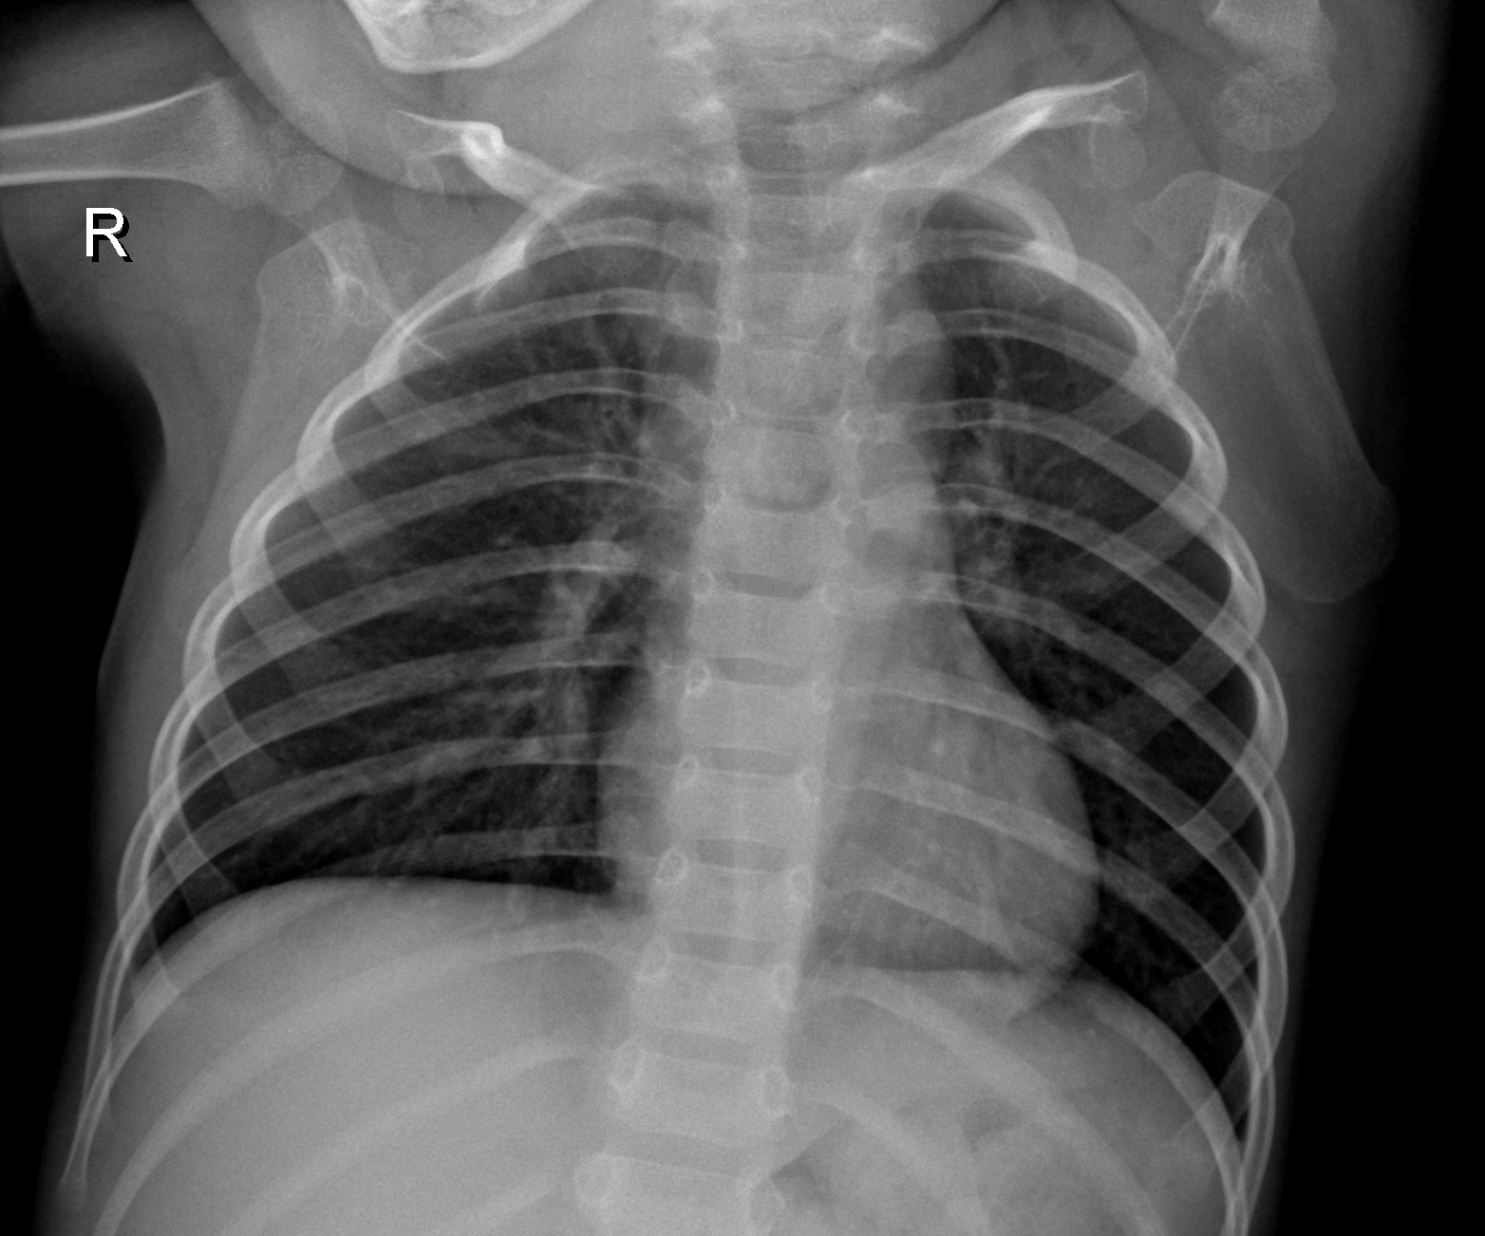
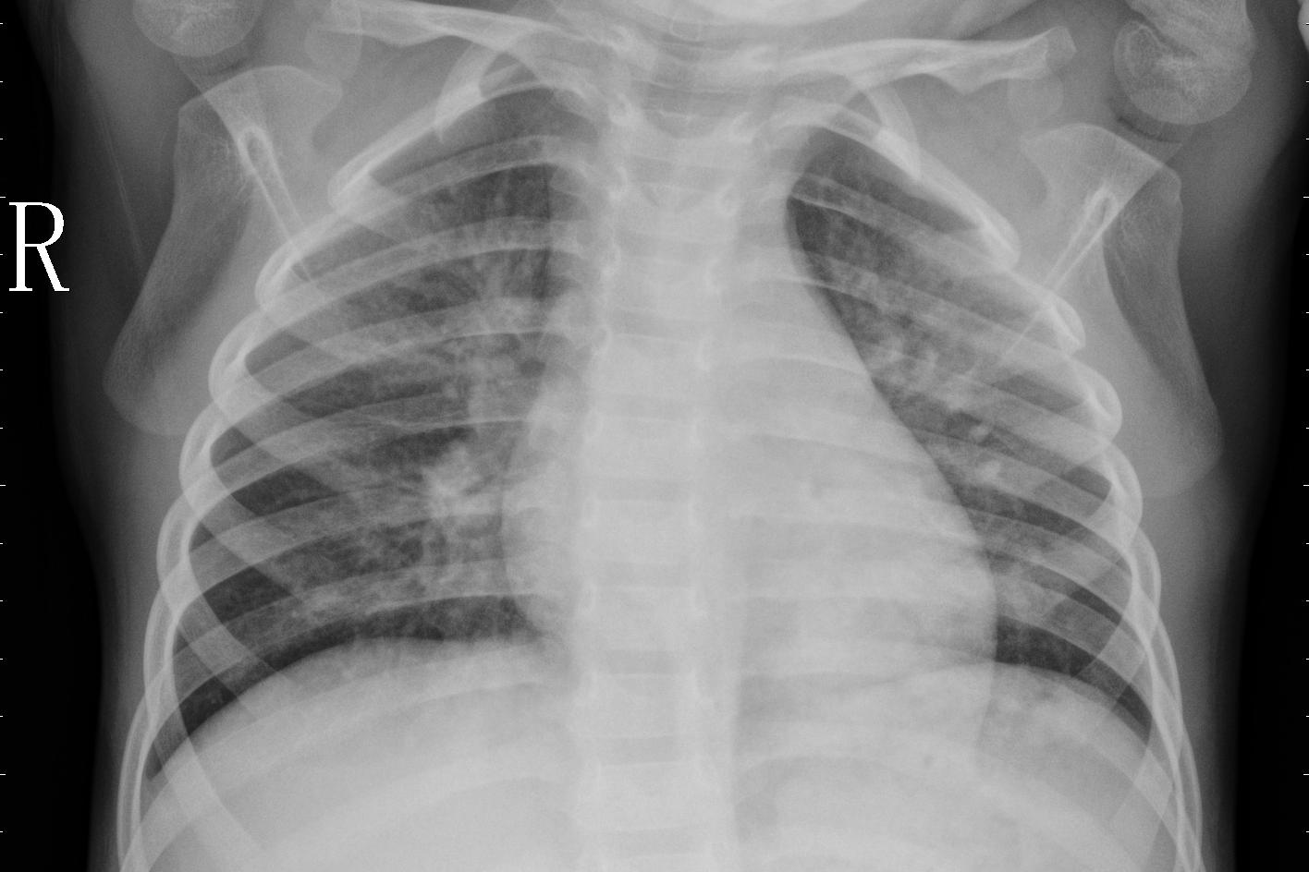
ABOUT DATASET
Chest X-Ray Images (Pneumonia)[6]
Img: 2
Normal Chest X-Ray
Pneumonia Chest X-Ray
The dataset consist of 5,863 X-Ray images and 2 categories (Pneumonia/Normal).
All Chest X-rays are of patients from Guangzhou Medical Center, Guangzhou.
All images are converted to 224X224 pixel for uniformity.
Credit: Daniel Kermany ,Kang Zhang ,Michael Goldbaum, https://data.mendeley.com/datasets/rscbjbr9sj/2

Slide 8
TEST DATA
Test Images: 41 X-Ray images taken from Amicare Hospital, Ghaziabad, UP[7]
The test images consist of 41 X-Ray images and 2 categories (Pneumonia/Normal).
All Chest X-rays are collected from radiology department Amicare Hospital, Ghaziabad, UP.
All images were pre classified by radiologists in respective categories.
Credit: Amicare Hospitals, Ghaziabad, Uttar Pradesh

Slide 9
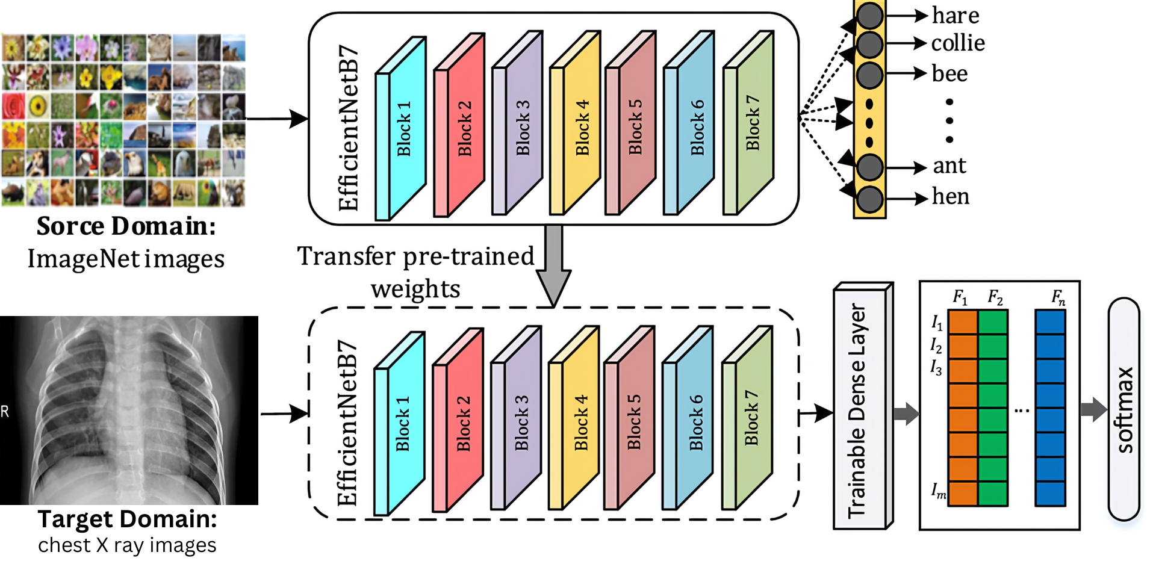
X-Ray Image Classification
Img:3
Transfer learning is state of the art technique taking features learned on one problem, and leveraging them on a new, similar problem.

Slide 10
RESULT AND ANALYSIS
 | EfficentNetB7 | EfficentNetB3 | VVG16 | Resnet50v2
Train Accuracy | 1.0000 | 1.0000 | 0.9773 | 0.9284
Test Accuracy | 0.9830 | 0.9830 | 0.9659 | 0.8920
Validation Accuracy | 0.9904 | 0.9713 | 0.9761 | 0.8971
Training Loss | 0.0011 | 0.0146 | 0.0856 | 0.3831
Precision | - | - | - | -
Normal | 0.92 | 0.90 | 0.96 | 1.00
Pneumonia | 0.99 | 0.98 | 0.97 | 0.90
Recall | - | - | - | -
Normal | 0.97 | 0.95 | 0.90 | 0.65
Pneumonia | 0.97 | 0.97 | 0.99 | 1.00
F1-Score | - | - | - | -
Normal | 0.95 | 0.93 | 0.93 | 0.79
Pneumonia | 0.98 | 0.98 | 0.98 | 0.95

Slide 11
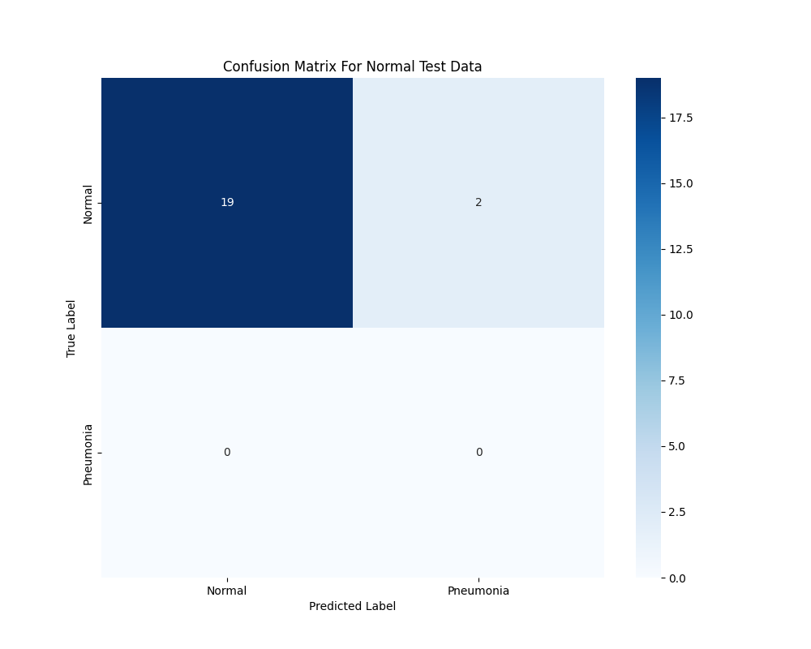
Test Data Result (Normal)
Results for Normal Test data are as follows:
Accuracy: 0.90
Precision: 1.00
Recall: 0.90
F1-Score: 0.95
Img: 4

Slide 12
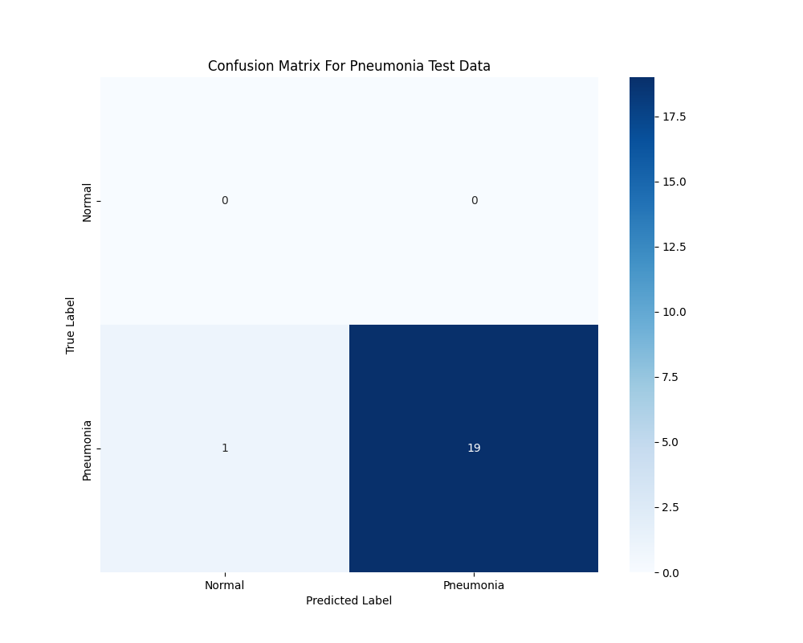
Test Data Result (Pneumonia)
Results for Pneumonia Test data are as follows:
Accuracy: 0.90
Precision: 1.00
Recall: 0.95
F1-Score: 0.97
Img: 5

Slide 13
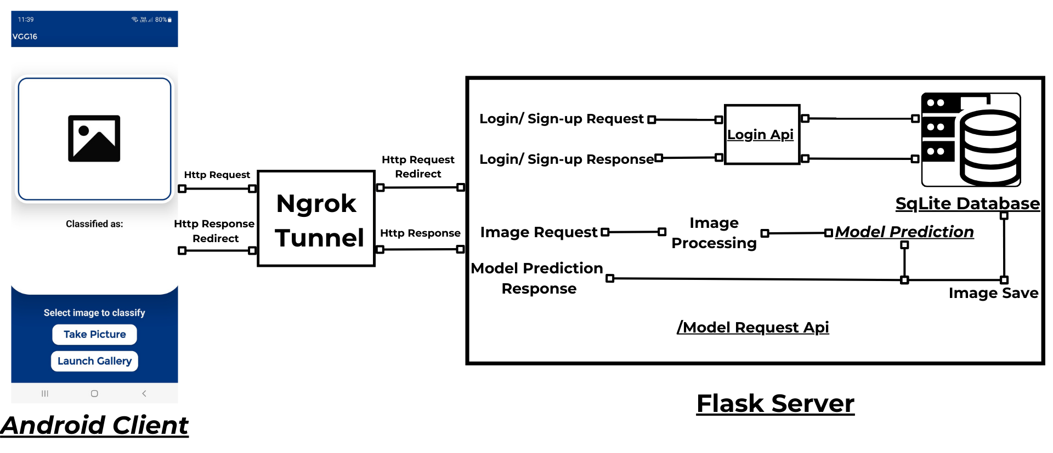
Deployment Architecture
Img:6

Slide 14


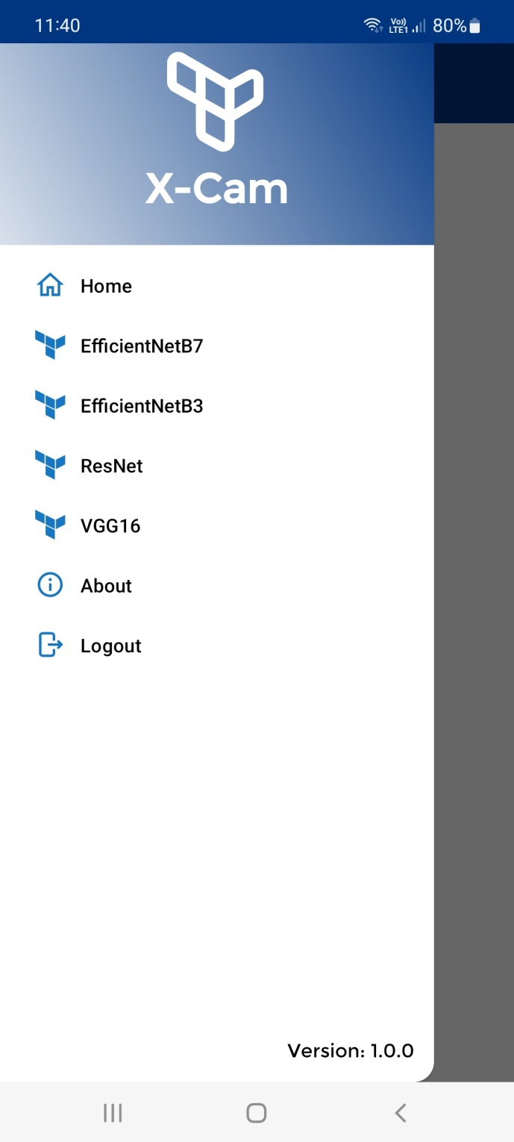
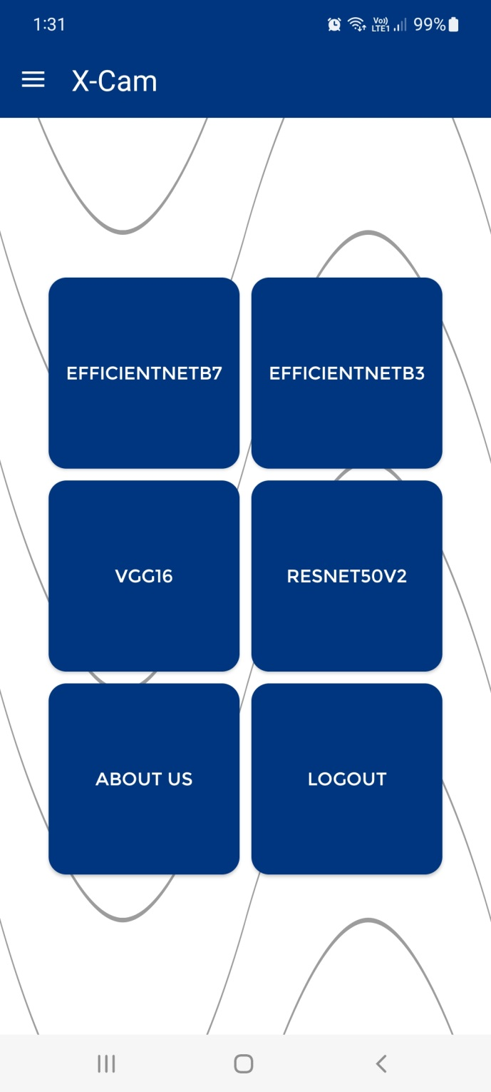

Slide 15
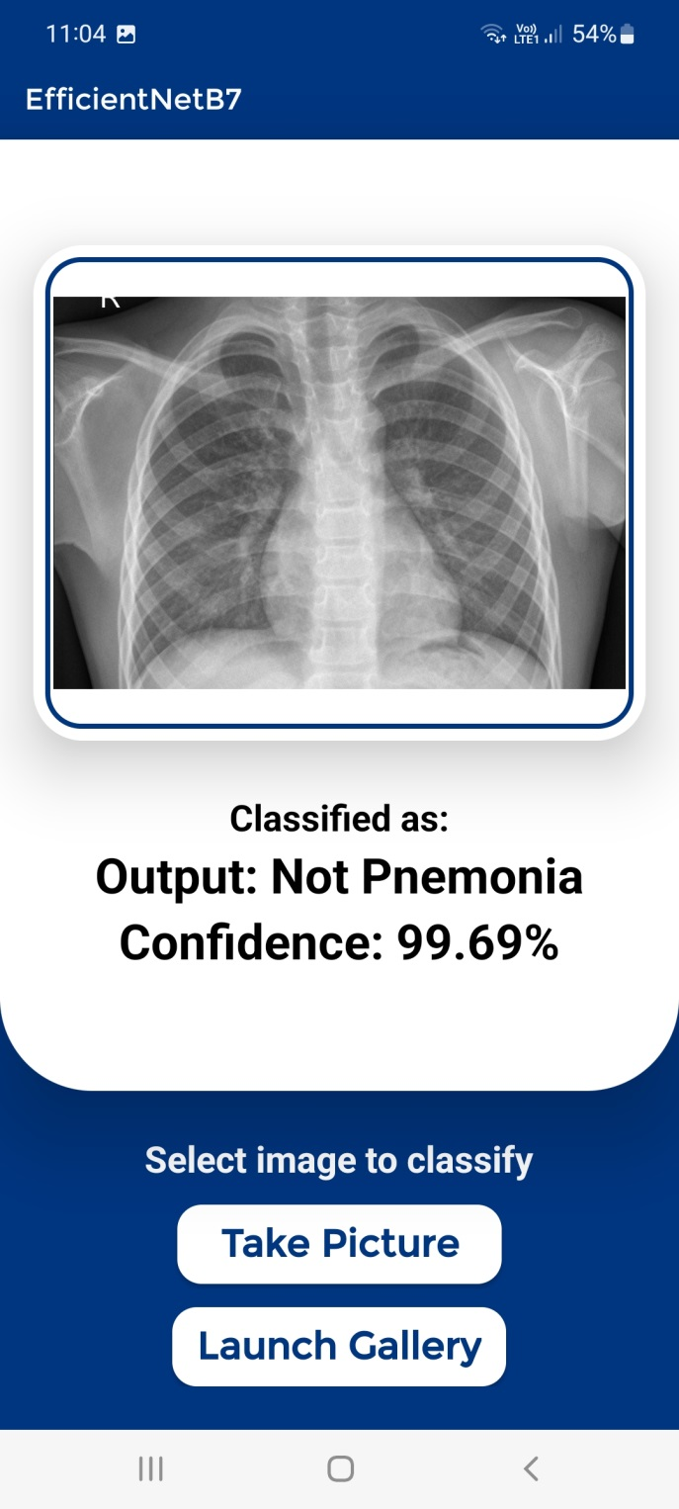
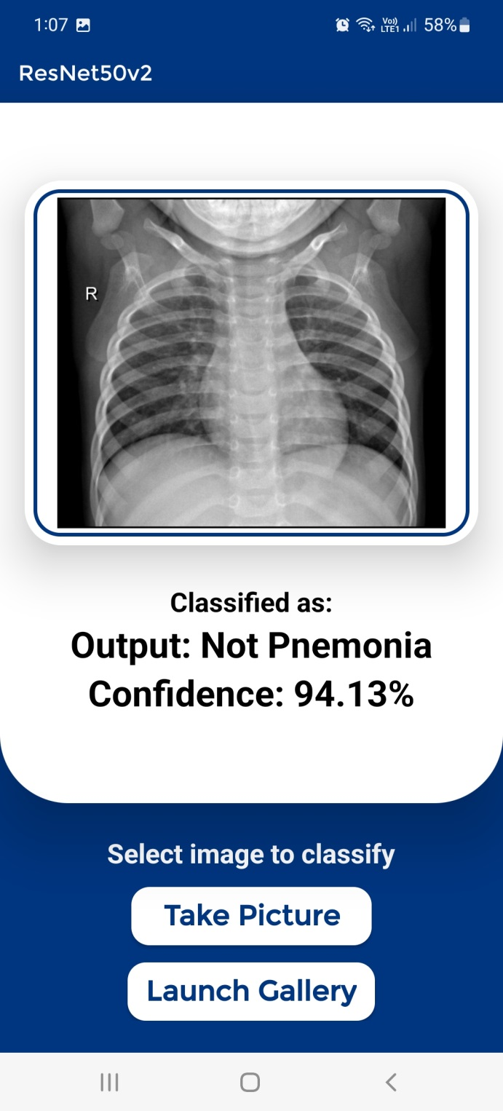
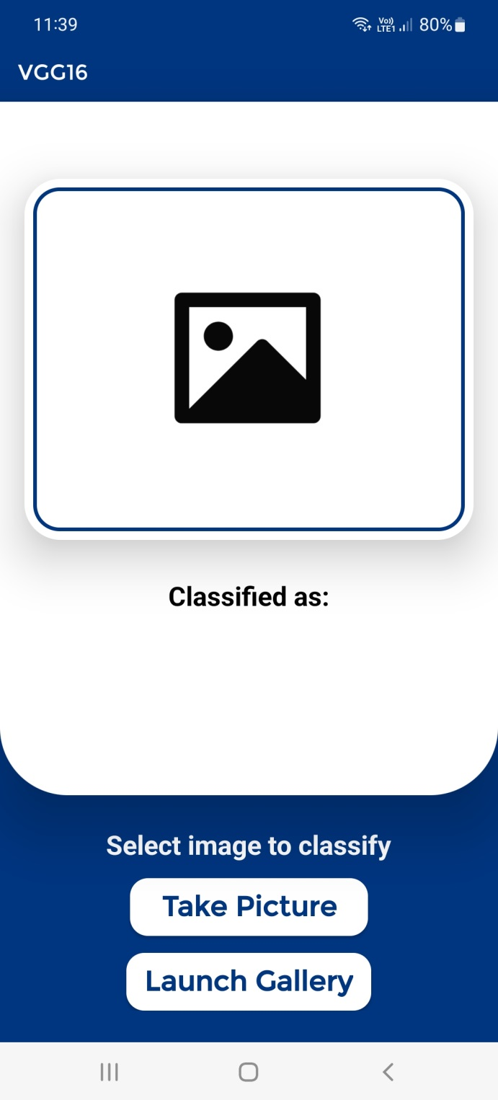
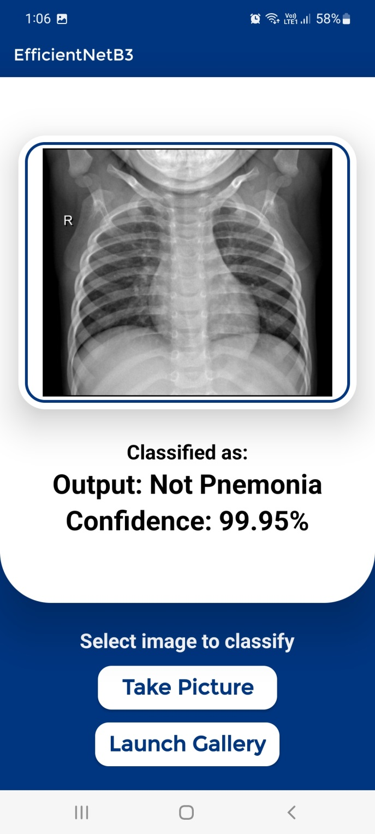

Slide 16
Conclusions
This project aimed to develop a robust and efficient deep learning model for pneumonia detection using chest X-ray images.
Our final model, EfficientNetB7, demonstrated superior performance, achieving higher accuracy and better generalization compared to VGG16, EfficientNetB3, and ResNet50V2.
The development of an Android application and a Flask server to facilitate the deployment and accessibility of the model.
Overall, this project successfully addressed key challenges in pneumonia detection, providing a reliable tool that can assist healthcare professionals in early and accurate diagnosis.

Slide 17
FUTURE WORK
Dataset Enhancement: Collect a larger and more diverse dataset to improve model generalization.
Model Improvements: Explore other advanced architectures like EfficientNetV2, DenseNet.
Multi-class Classification: Develop a multi-class classification model that can identify various lung diseases beyond pneumonia, such as tuberculosis, lung cancer.
Additional Test Data: Incorporate more diverse test data for more comprehensive test results.

Slide 18
REFERENCES
[1] Hicham Moujahid, Bouchaib Cherradi, Oussama El Gannour, Lhoussain Ba hatti, Oumaima Terrada & Soufiane Hamida (2020). Convolutional Neural Network Based Classification of Patients with Pneumonia using X-ray Lung Images. Advances in Science, Technology and Engineering Systems Journal Vol. 5, No. 5, 167-175. https://dx.doi.org/10.25046/aj050522
[2] Dimpy Varshni, Kartik Thakral, Lucky Agarwal, Rahul Nijhawan & Ankush Mittal (2019). Pneumonia Detection Using CNN based Feature Extrac tion. 2019 IEEE International Conference on Electrical, Computer and Communication Technologies (ICECCT), Coimbatore, India, 2019, pp. 1 7. https://dx.doi.org/10.1109/ICECCT.2019.8869364
[3] Kishore Medhi, Md. Jamil & Md. Iftekhar Hussain (2020). Automatic Detection of COVID-19 Infection from Chest X-ray using Deep Learning. medRxiv preprint doi: https://doi.org/10.1101/2020.05.10.20097063
[4] Jie Hou1 & Terry Gao (2021). Explainable DCNN based chest X-ray image analysis and classification for COVID-19 pneumonia detection. Sci Rep 11, 16071 (2021). https://doi.org/10.1038/s41598-021-95680-6
[5] Terry Gao, Grace Wang (2020). Chest X-ray image analysis and classification for COVID-19 pneumonia detection using Deep CNN. medRxiv 2020.08.20.20178913; doi: https://doi.org/10.1101/2020.08.20.20178913
[6] Kermany, Daniel; Zhang, Kang; Goldbaum, Michael (2018), Labeled Optical Coherence Tomography (OCT) and Chest X-Ray Images for Classification. Mendeley Data ,V1, doi: 10.17632/rscbjbr9sj.2, Labeled Optical Coherence Tomography (OCT) and Chest X-Ray Images for Classification - Mendeley Data
[7] Amicare Hospitals, 41 Anterior- posterior X –ray images for Test Data.
dshahid (2019). Convolutional Neural Network. Towards data science: https://towardsdatascience.com/covolutional-neural-network-cb088 3dd6529
Dipanjan Sarkar (2018). A Comprehensive Hands-on Guide to Transfer Learning with Real-World Applications in Deep Learning. Towards data science: https://towardsdatascience.com/a-comprehensive-hands-on-guide-to-transfer-learning-with-real-world-applications-in-deep-learning-212bf3b2f27a
dshahid (2019). Introduction to Tensorflow. Medium: https://medium.com/@dshahid380/introduction-to-tensorflow-32d83ece1d64
Mrudul Shah (2019). How to Apply Machine Learning (ML) in an Android App. Towards data science: https://towardsdatascience.com/how-to-a pply-machine-learning-ml-in-an-android-app-33e848c0dde6
Furkan Artun¸c (2020). Serving Machine Learning Models from Python. To wards data science: https://towardsdatascience.com/serving-machine-learning-models-from-python-bd8c43fb61d5
Jimit Dholakia (2020). Creating RESTful Web APIs using Flask and Python. Towards data science: https://towardsdatascience.com/creating-restful-apis-using-flask-and-python-655bad51b24
Img: 1: https://www.turing.com/kb/all-you-need-to-know-about-computer-vision
Img: 3: https://www.turing.com/kb/all-you-need-to-know-about-computer-vision

Slide 19
THANK YOU

